Slide 1
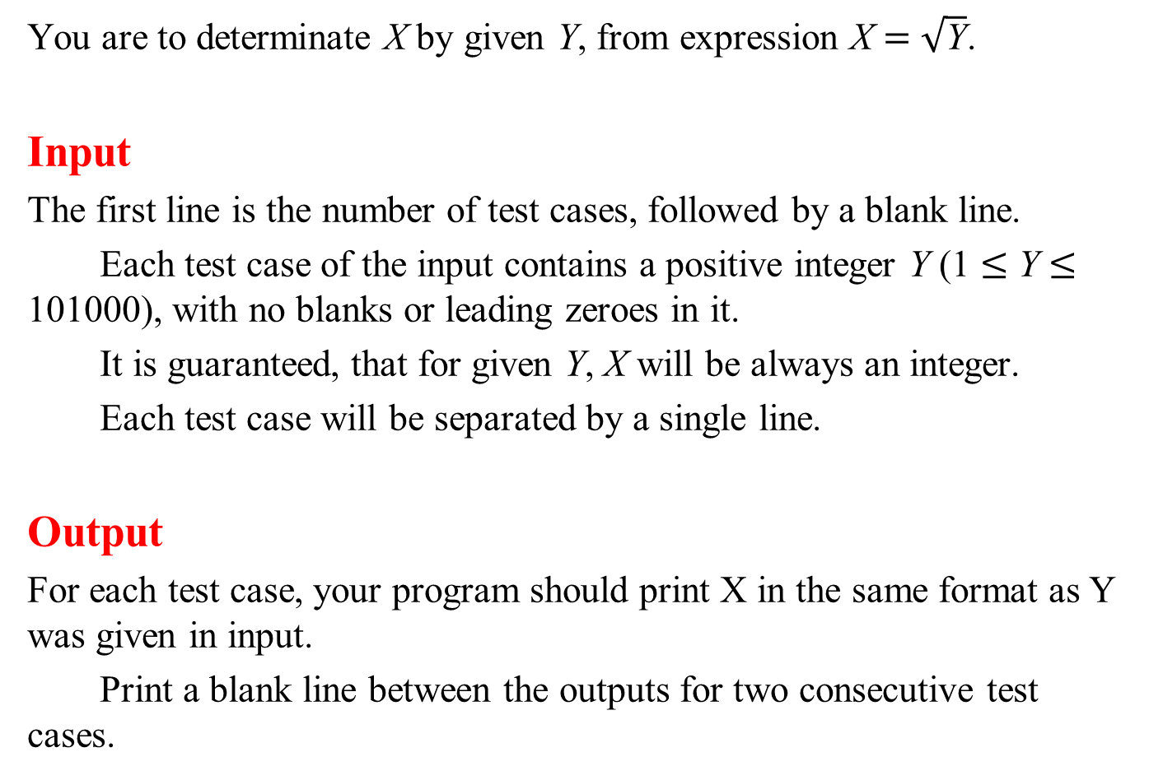
You are to determinate X by given Y, from expression X = $\sqrt{\text{Y}}$.
Input
The first line is the number of test cases, followed by a blank line.
Each test case of the input contains a positive integer Y (1 ≤ Y ≤ 101000), with no blanks or leading zeroes in it.
It is guaranteed, that for given Y, X will be always an integer.
Each test case will be separated by a single line.
Output
For each test case, your program should print X in the same format as Y was given in input.
Print a blank line between the outputs for two consecutive test cases.

Slide 2
Sample Input
1
7206604678144
Sample Output
2684512

Slide 3
Class

Slide 4
class HugeInt
{
public:
HugeInt compSquareRoot();
HugeInt compSquare();
bool equal( HugeInt &hugeInt2 );
bool less( HugeInt &hugeInt2 );
size_t size = 0;
long long int *integer = nullptr;
};
for( int i = 1; i <= testCase; i++ )
{
char str[ 1010 ] = {};
cin >> str;
size_t numDigits = strlen( str );
if( numDigits < 10 )
cout << sqrt( atoi( str ) ) << endl;
else

Slide 5
{
int *digits = new int[ numDigits + 3 ]();
for( size_t j = 0; j < numDigits; ++j )
digits[ j ] = str[ numDigits - 1 - j ] - '0';
size_t last = ( numDigits - 1 ) / 4;
HugeInt hugeInt;
hugeInt.size = last + 1;
hugeInt.integer = new long long int[ hugeInt.size ]();
for( size_t j = 0; j <= last; j++ )
hugeInt.integer[ j ] = digits[ 4 * j ] +
digits[ 4 * j + 1 ] * 10 +
digits[ 4 * j + 2 ] * 100 +
digits[ 4 * j + 3 ] * 1000;
HugeInt squareRoot = compSquareRoot( hugeInt );
cout << squareRoot.integer[ squareRoot.size - 1 ];
for( int j = squareRoot.size - 2; j >= 0; j-- )
cout << setw( 4 ) << setfill( '0' ) << squareRoot.integer[ j ];
cout << endl;
}

Slide 6
int *digits = new int[ numDigits + 3 ]();
for( size_t j = 0; j < numDigits; ++j )
digits[ j ] = str[ numDigits - 1 - j ] - '0';
0 | 1 | 2 | 3 | 4 | 5 | 6 | 7 | 8 | 9 | 10 | 11 | 12 | 13 | 14 | 15
7 | 2 | 0 | 6 | 6 | 0 | 4 | 6 | 7 | 8 | 1 | 4 | 4 | \0
str
0 | 1 | 2 | 3 | 4 | 5 | 6 | 7 | 8 | 9 | 10 | 11 | 12 | 13 | 14 | 15
4 | 4 | 1 | 8 | 7 | 6 | 4 | 0 | 6 | 6 | 0 | 2 | 7 | 0 | 0 | 0
digits
15 | 14 | 13 | 12 | 11 | 10 | 9 | 8 | 7 | 6 | 5 | 4 | 3 | 2 | 1 | 0
0 | 0 | 0 | 7 | 2 | 0 | 6 | 6 | 0 | 4 | 6 | 7 | 8 | 1 | 4 | 4
digits

Slide 7
size_t last = ( numDigits - 1 ) / 4;
HugeInt hugeInt;
hugeInt.size = last + 1;
hugeInt.integer = new long long int[ hugeInt.size ]();
for( size_t j = 0; j <= last; j++ )
hugeInt.integer[ j ] = digits[ 4 * j ] +
digits[ 4 * j + 1 ] * 10 +
digits[ 4 * j + 2 ] * 100 +
digits[ 4 * j + 3 ] * 1000;
15 | 14 | 13 | 12 | 11 | 10 | 9 | 8 | 7 | 6 | 5 | 4 | 3 | 2 | 1 | 0
0 | 0 | 0 | 7 | 2 | 0 | 6 | 6 | 0 | 4 | 6 | 7 | 8 | 1 | 4 | 4
digits
4
size
3 | 2 | 1 | 0
7 | 2066 | 0467 | 8144
hugeInt
integer

Slide 8
Square Root
4
size
3 | 2 | 1 | 0
7 | 2066 | 0467 | 8144
hugeInt
integer
4
size
1 | 0
0 | 0
sqrt
0
integer
9999
low
high
4
size
3 | 2 | 1 | 0
0 | 0 | 0 | 0
square
integer

Slide 9
vector

Slide 10
vector< long long int > compSquareRoot( vector< long long int >
&hugeInt );
vector< long long int > compSquare( vector< long long int >
&hugeInt );
bool equal( vector< long long int > &hugeInt1,
vector< long long int > &hugeInt2 );
bool less( vector< long long int > &hugeInt1,
vector< long long int > &hugeInt2 );
for( int i = 1; i <= testCase; i++ )
{
char str[ arraySize ] = {};
cin >> str;
size_t numDigits = strlen( str );
if( numDigits < 10 )
cout << sqrt( atoi( str ) ) << endl;
else

Slide 11
{
vector< long long int > digits( numDigits + 3 );
for( size_t j = 0; j < numDigits; ++j )
digits[ j ] = str[ numDigits - 1 - j ] - '0';
size_t last = ( numDigits - 1 ) / 4;
vector< long long int > hugeInt( last + 1 );
for( size_t j = 0; j <= last; j++ )
hugeInt[ j ] = digits[ 4 * j ] +
digits[ 4 * j + 1 ] * 10 +
digits[ 4 * j + 2 ] * 100 +
digits[ 4 * j + 3 ] * 1000;
vector< long long int > squareRoot = compSquareRoot( hugeInt );
cout << squareRoot[ squareRoot.size() - 1 ];
for( int j = squareRoot.size() - 2; j >= 0; j-- )
cout << setw( 4 ) << setfill( '0' ) << squareRoot[ j ];
cout << endl;
}

